Slide 1
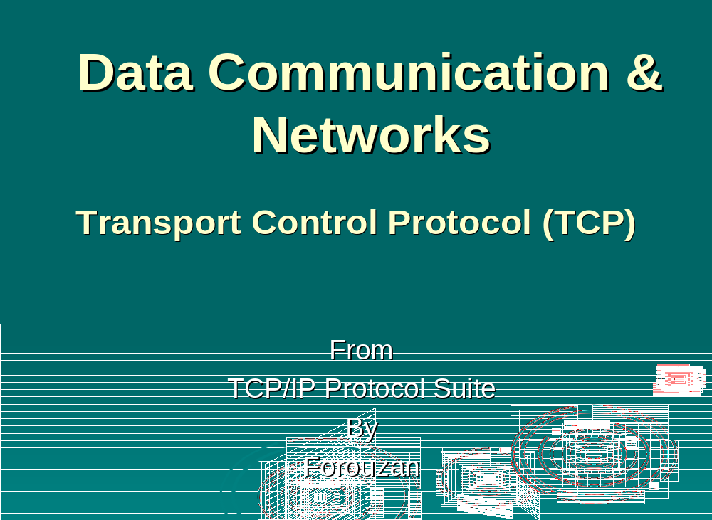

Slide 2

Chapter 12
Transmission
Control Protocol
Objectives
Upon completion you will be able to:
Be able to name and understand the services offered by TCP
Understand TCP’s flow and error control and congestion control
Be familiar with the fields in a TCP segment
Understand the phases in a connection-oriented connection
Understand the TCP transition state diagram
Be able to name and understand the timers used in TCP
Be familiar with the TCP options

Slide 3
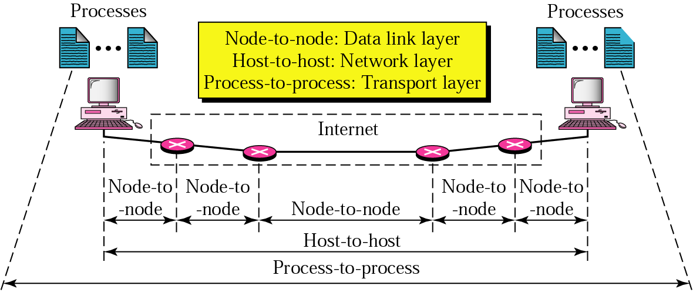
Process-to-process Communication

Slide 4
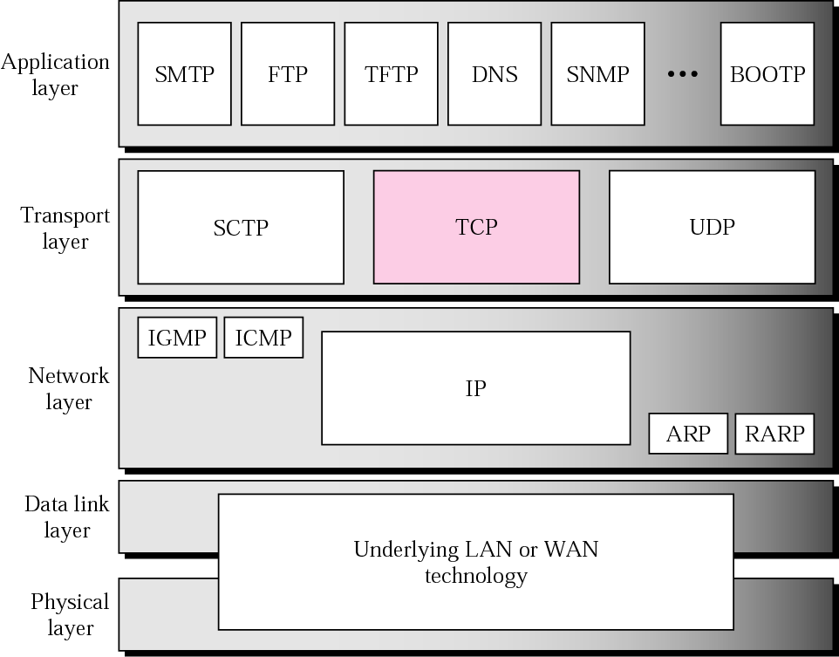
Figure 12.1 TCP/IP protocol suite

Slide 5
12.1 TCP SERVICES
We explain the services offered by TCP to the processes at the application layer.
The topics discussed in this section include:
Process-to-Process Communication
Stream Delivery Service
Full-Duplex Communication
Connection-Oriented Service
Reliable Service

Slide 6
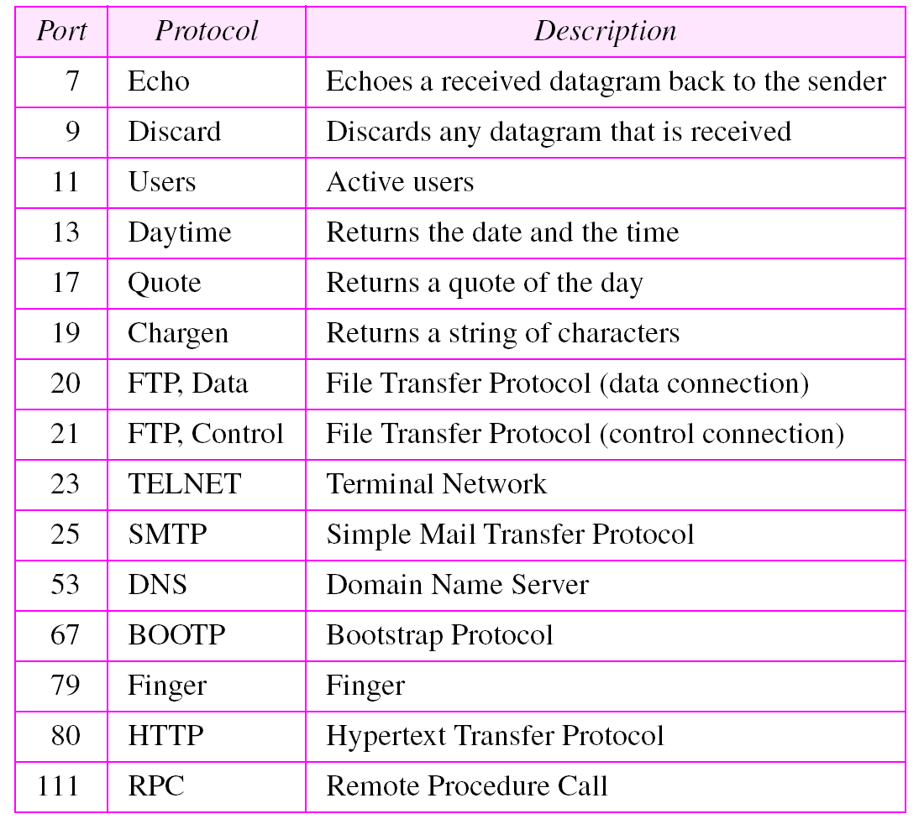
Table 12.1 Well-known ports used by TCP

Slide 7
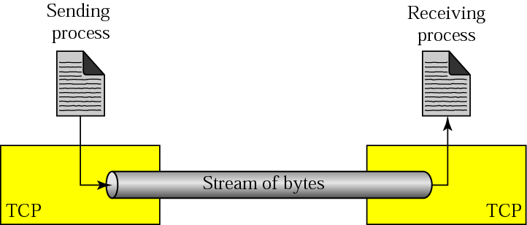
Figure 12.2 Stream delivery

Slide 8
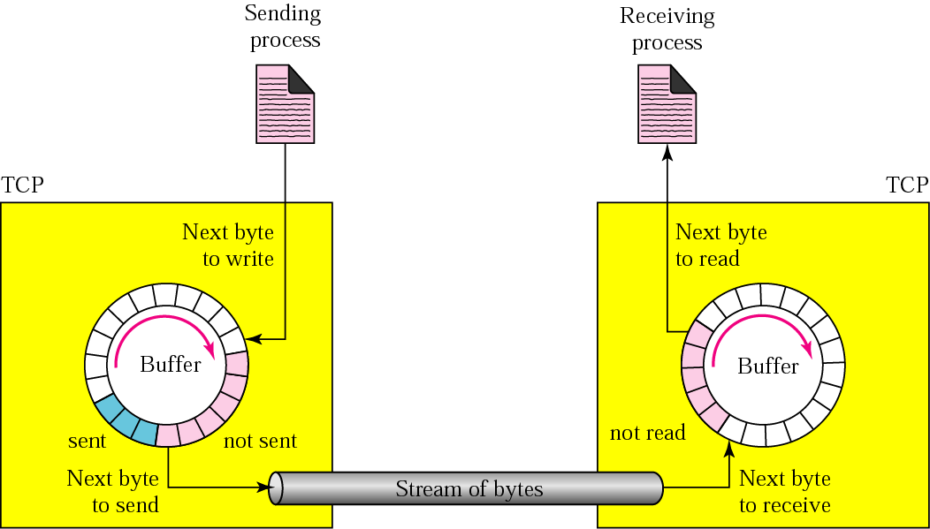
Figure 12.3 Sending and receiving buffers

Slide 9
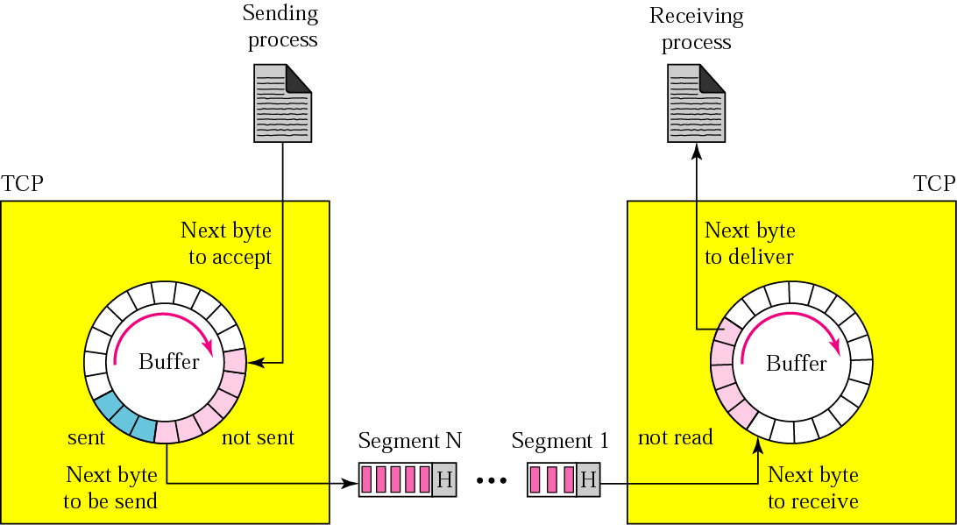
Figure 12.4 TCP segments

Slide 10
12.2 TCP FEATURES
To provide the services mentioned in the previous section, TCP has several features that are briefly summarized in this section.
The topics discussed in this section include:
Numbering System
Flow Control
Error Control
Congestion Control

Slide 11

Note:
The bytes of data being transferred in each connection are numbered by TCP. The numbering starts with a randomly generated number.

Slide 12
Example 2
Suppose a TCP connection is transferring a file of 5000 bytes. The first byte is numbered 10001. What are the sequence numbers for each segment if data is sent in five segments, each carrying 1000 bytes?
Solution
The following shows the sequence number for each segment:
Segment 1 ➡ Sequence Number: 10,001 (range: 10,001 to 11,000)
Segment 2 ➡ Sequence Number: 11,001 (range: 11,001 to 12,000)
Segment 3 ➡ Sequence Number: 12,001 (range: 12,001 to 13,000)
Segment 4 ➡ Sequence Number: 13,001 (range: 13,001 to 14,000)
Segment 5 ➡ Sequence Number: 14,001 (range: 14,001 to 15,000)

Slide 13
Note:
The value in the sequence number field of a segment defines the number of the first data byte contained
in that segment.

Slide 14
Note:
The value of the acknowledgment field in a segment defines the number of the next byte a party expects to receive.
The acknowledgment number is cumulative.

Slide 15
12.3 SEGMENT
A packet in TCP is called a segment
The topics discussed in this section include:
Format
Encapsulation

Slide 16
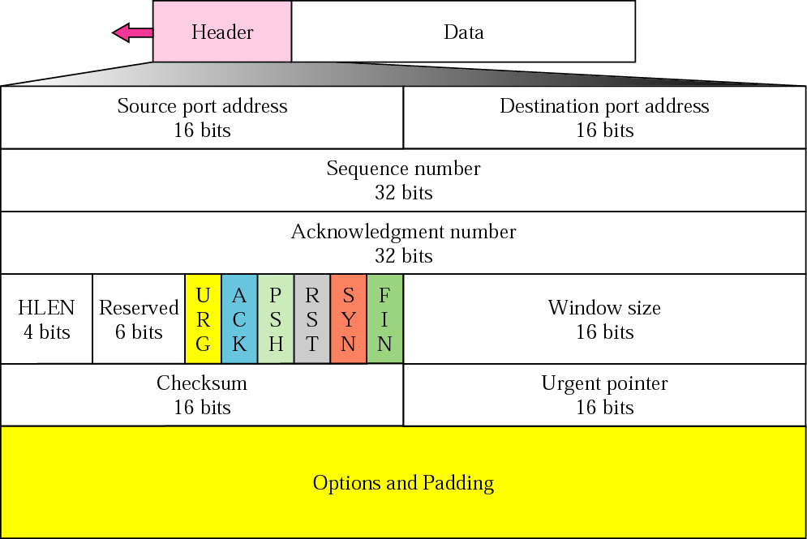
Figure 12.5 TCP segment format

Slide 17
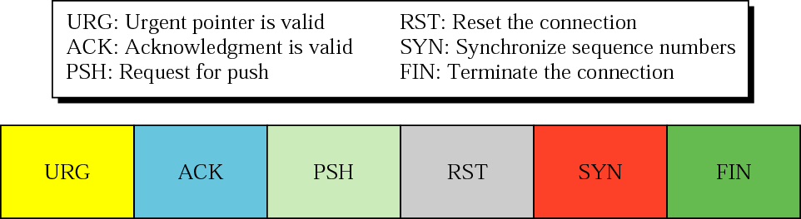
Figure 12.6 Control field

Slide 18
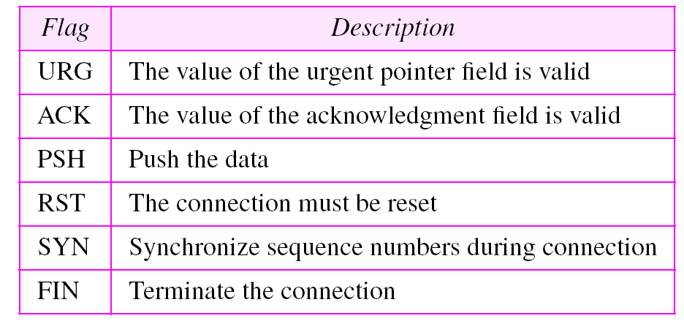
Table 12.2 Description of flags in the control field
I

Slide 19
Note:
The inclusion of the checksum in TCP is mandatory.

Slide 20

Figure 12.8 Encapsulation and decapsulation

Slide 21
12.4 A TCP CONNECTION
TCP is connection-oriented. A connection-oriented transport protocol establishes a virtual path between the source and destination. All of the segments belonging to a message are then sent over this virtual path. A connection-oriented transmission requires three phases: connection establishment, data transfer, and connection termination.
The topics discussed in this section include:
Connection Establishment
Data Transfer
Connection Termination
Connection Reset

Slide 22
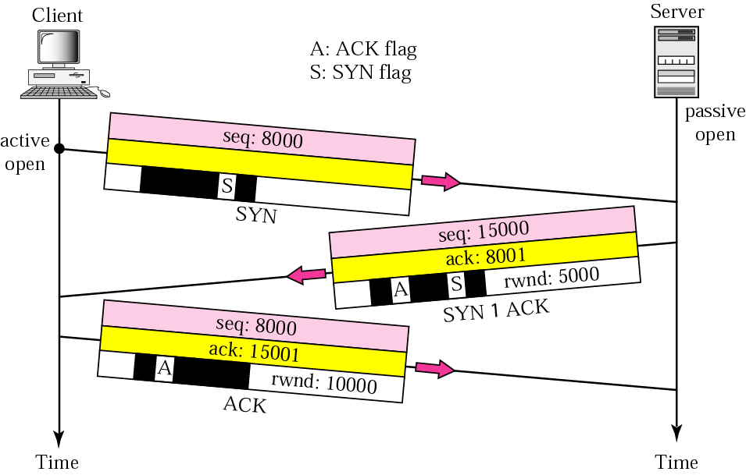
Figure 12.9 Connection establishment using three-way handshaking

Slide 23
Note:
A SYN segment cannot carry data, but it consumes one sequence number.

Slide 24
Note:
A SYN + ACK segment cannot carry data, but does consume one
sequence number.

Slide 25
Note:
An ACK segment, if carrying no data, consumes no sequence number.

Slide 26
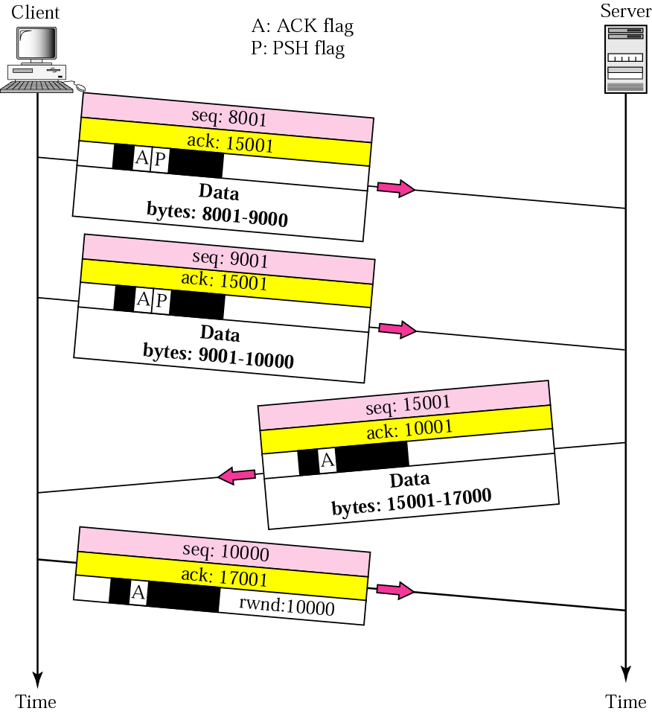
Figure 12.10 Data transfer

Slide 27
Note:
The FIN segment consumes one sequence number if it does not carry data.

Slide 28
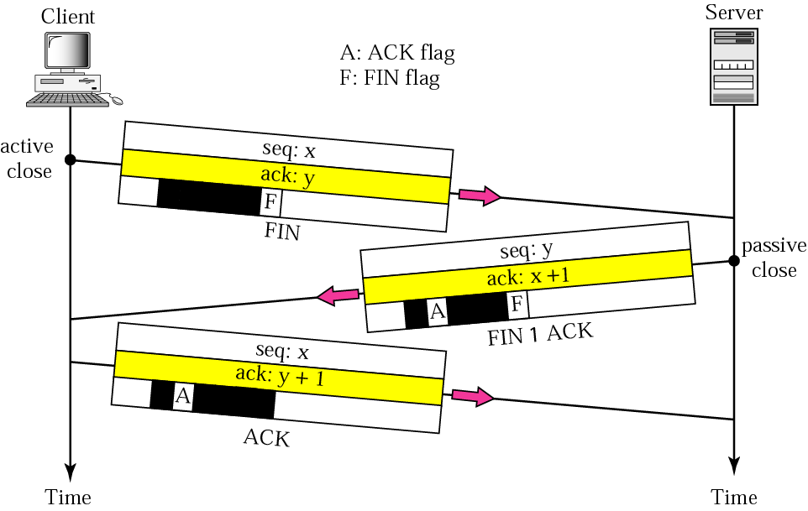
Figure 12.11 Connection termination using three-way handshaking

Slide 29
Note:
The FIN + ACK segment consumes one sequence number if it does not carry data.

Slide 30
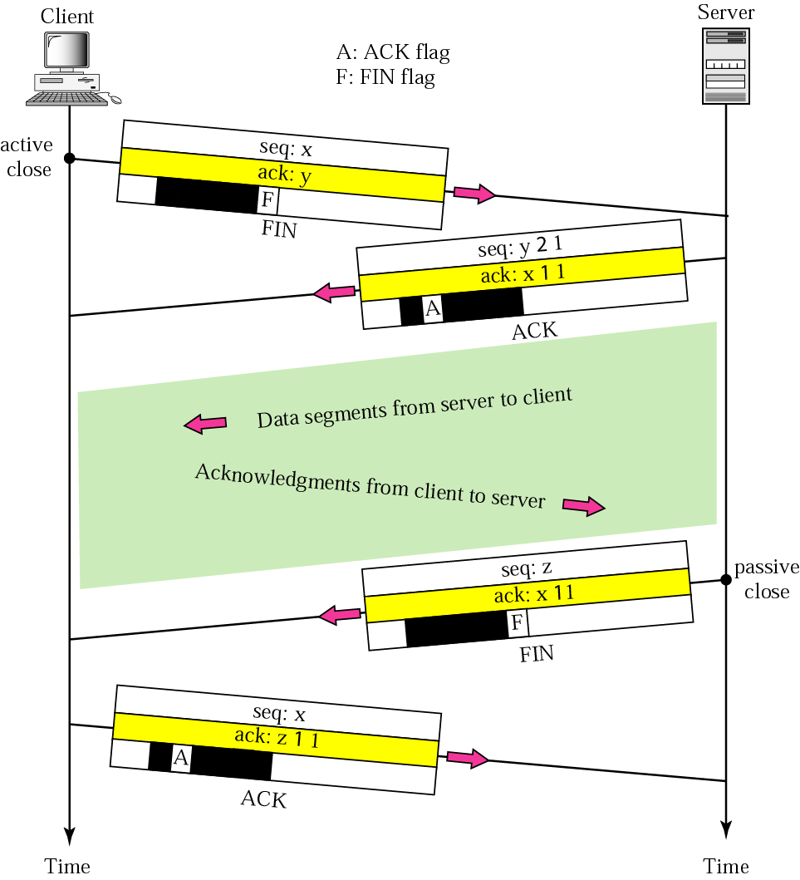
Figure 12.12 Half-close

Slide 31
12.5 STATE TRANSITION DIAGRAM
To keep track of all the different events happening during connection establishment, connection termination, and data transfer, the TCP software is implemented as a finite state machine. .
The topics discussed in this section include:
Scenarios

Slide 32
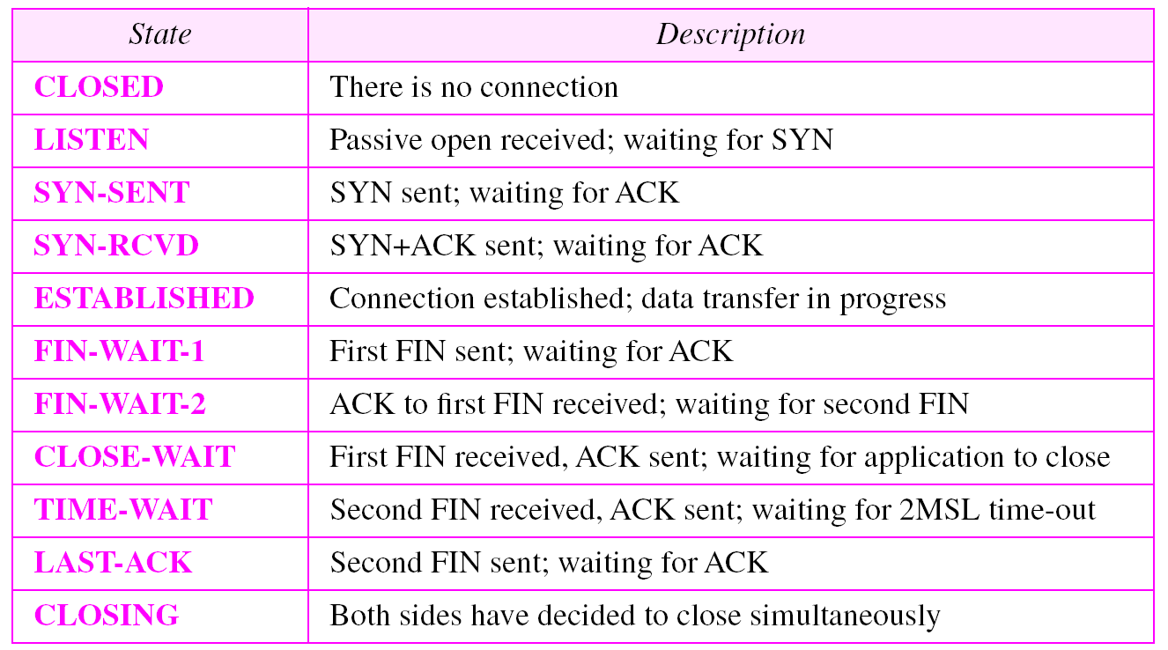
Table 12.3 States for TCP

Slide 33
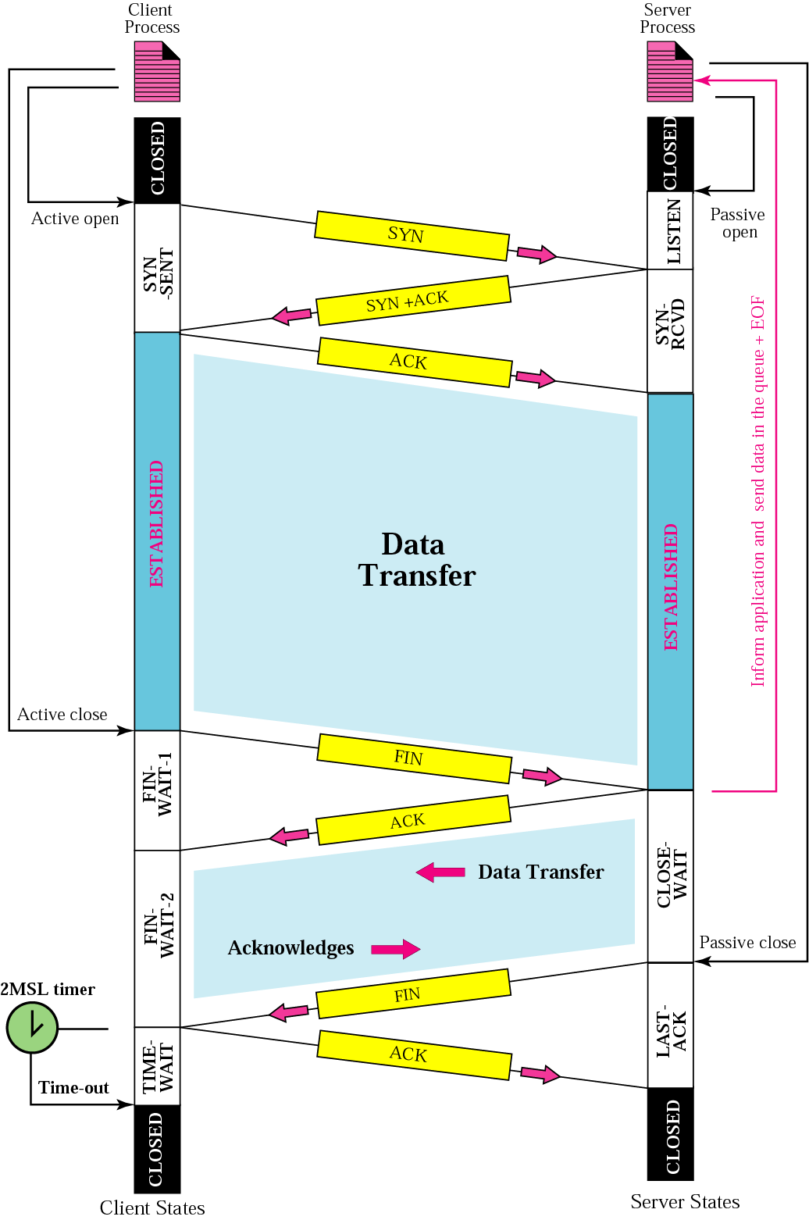
Figure 12.14 Common scenario

Slide 34
Note:
The common value for Max. Segment Lifetime (MSL) is between 30 seconds and 1 minute.

Slide 35
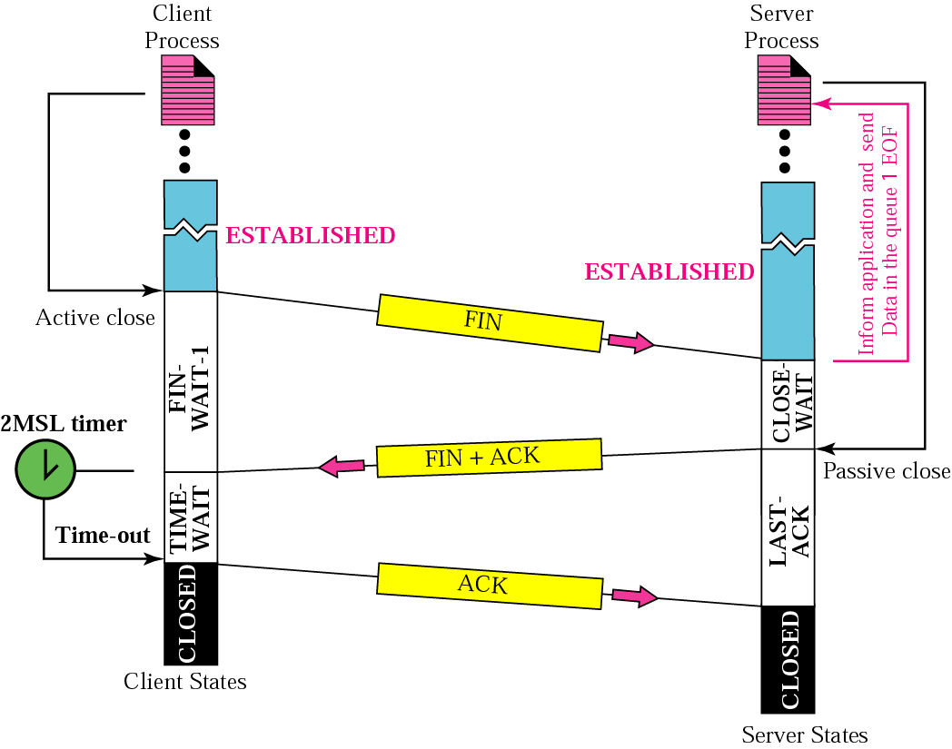
Figure 12.15 Three-way handshake

Slide 36
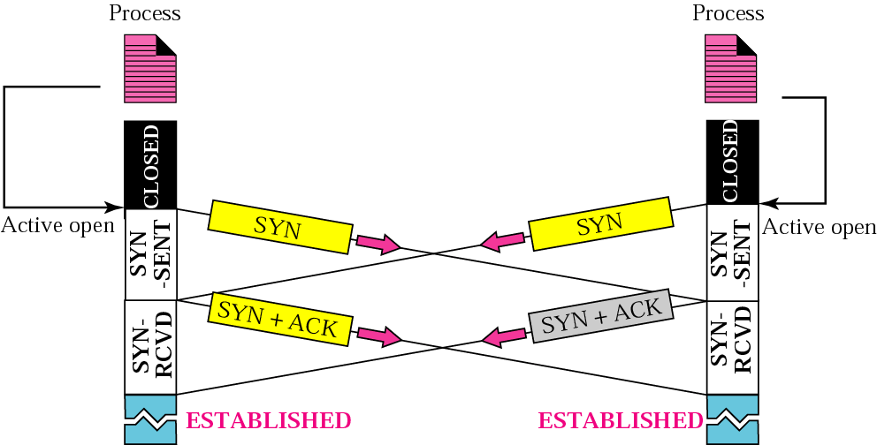
Figure 12.16 Simultaneous open

Slide 37
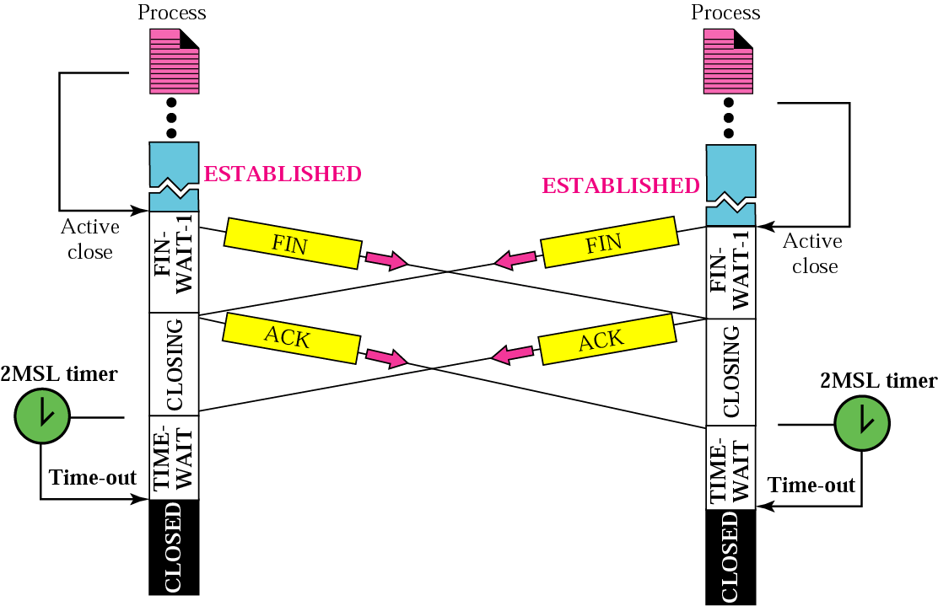
Figure 12.17 Simultaneous close

Slide 38
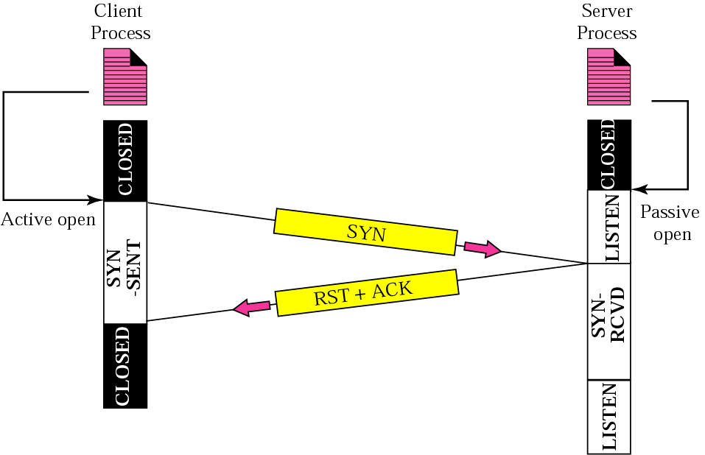
Figure 12.18 Denying a connection

Slide 39
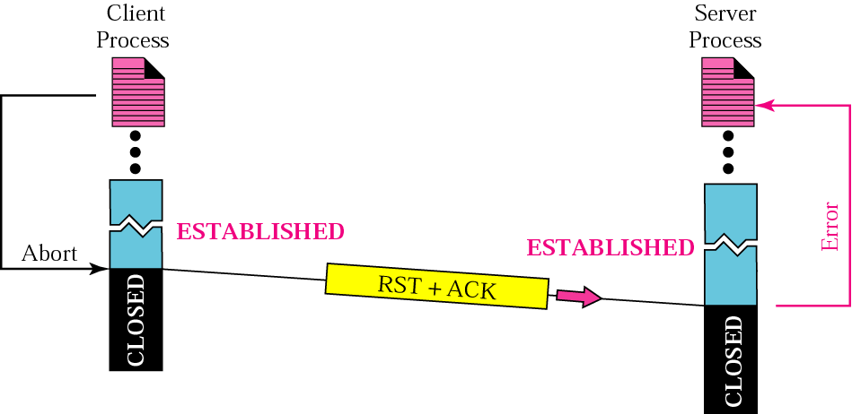
Figure 12.19 Aborting a connection

Slide 40
12.6 FLOW CONTROL
Flow control regulates the amount of data a source can send before receiving an acknowledgment from the destination. TCP defines a window that is imposed on the buffer of data delivered from the application program.
The topics discussed in this section include:
Sliding Window Protocol
Silly Window Syndrome

Slide 41
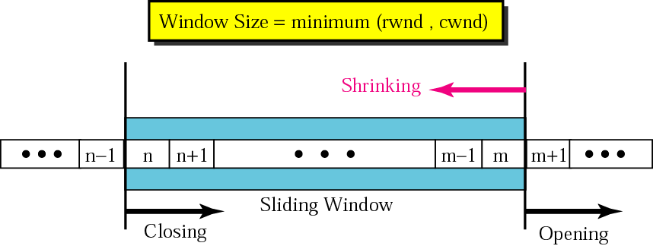
Figure 12.20 Sliding window

Slide 42
Note:
A sliding window is used to make transmission more efficient as well as to control the flow of data so that the destination does not become overwhelmed with data.
TCP’s sliding windows are byte oriented.

Slide 43
Note:
Some points about TCP’s sliding windows:
❏ The size of the window is the lesser of rwnd and cwnd.
❏ The source does not have to send a full window’s
worth of data.
❏ The window can be opened or closed by the receiver,
but should not be shrunk.
❏ The destination can send an acknowledgment at any
time as long as it does not result in a shrinking window.
❏ The receiver can temporarily shut down the window;
the sender, however, can always send a segment of one
byte after the window is shut down.

Slide 44
12.7 ERROR CONTROL
TCP provides reliability using error control, which detects corrupted, lost, out-of-order, and duplicated segments. Error control in TCP is achieved through the use of the checksum, acknowledgment, and time-out.
The topics discussed in this section include:
Checksum
Acknowledgment
Acknowledgment Type
Retransmission
Out-of-Order Segments
Some Scenarios

Slide 45
Note:
ACK segments do not consume sequence numbers and are not acknowledged.

Slide 46
Note:
In modern implementations, a retransmission occurs if the retransmission timer expires or three duplicate ACK segments have arrived.

Slide 47
Note:
No retransmission timer is set for an ACK segment.

Slide 48
Note:
Data may arrive out of order and be temporarily stored by the receiving TCP, but TCP guarantees that no out-of-order segment is delivered to the process.

Slide 49
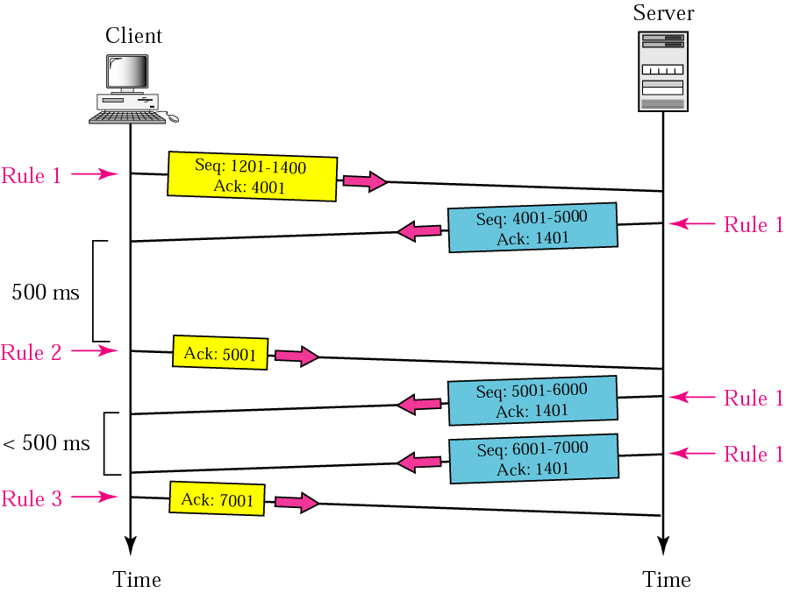
Figure 12.25 Normal operation

Slide 50
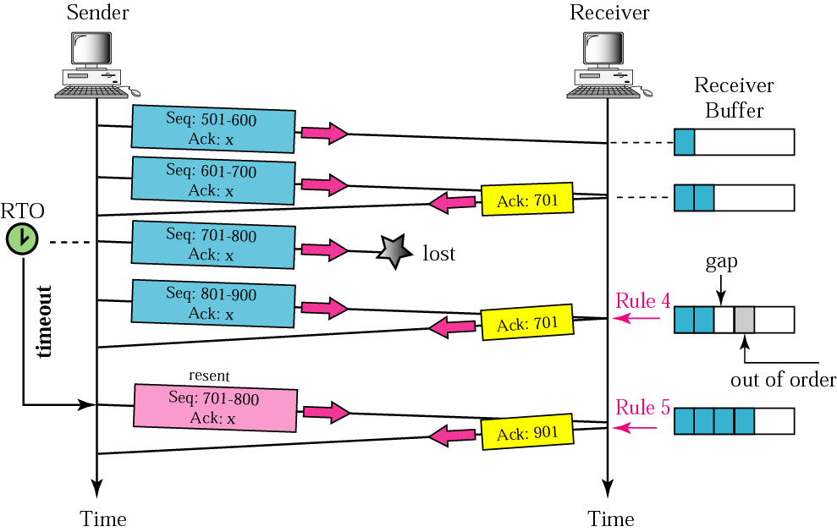
Figure 12.26 Lost segment

Slide 51
Note:
The receiver TCP delivers only ordered data to the process.

Slide 52
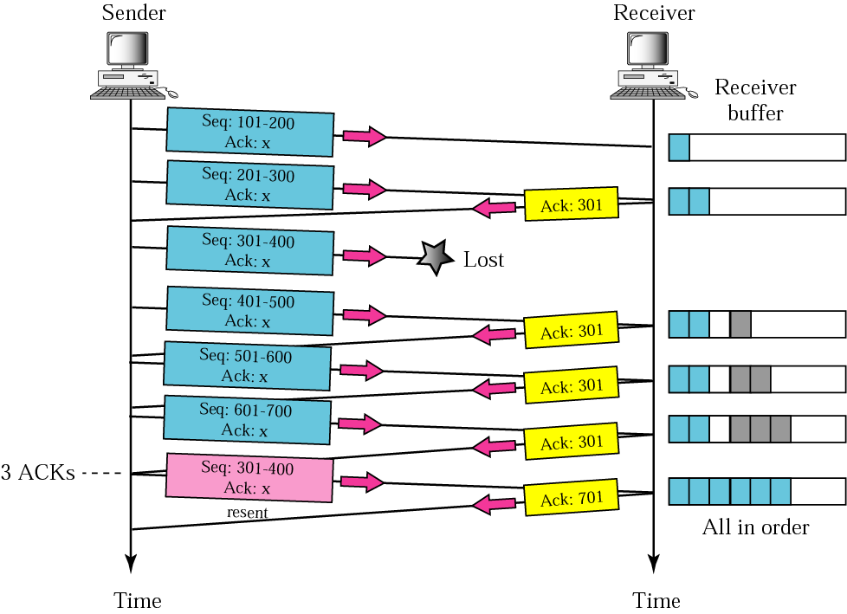
Figure 12.27 Fast retransmission

Slide 53
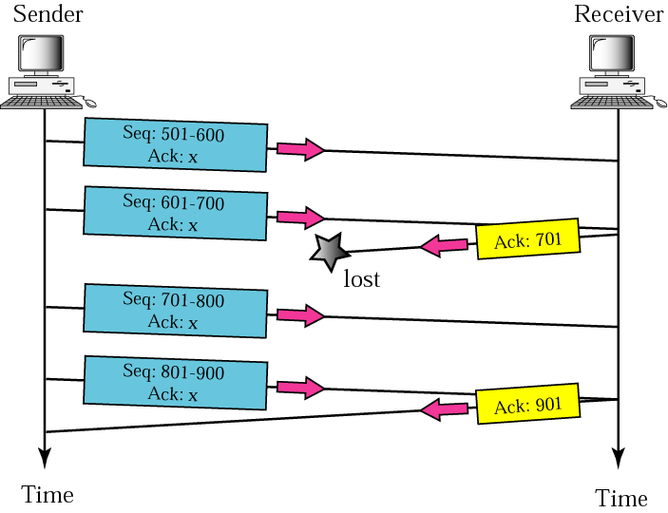
Figure 12.28 Lost acknowledgment

Slide 54
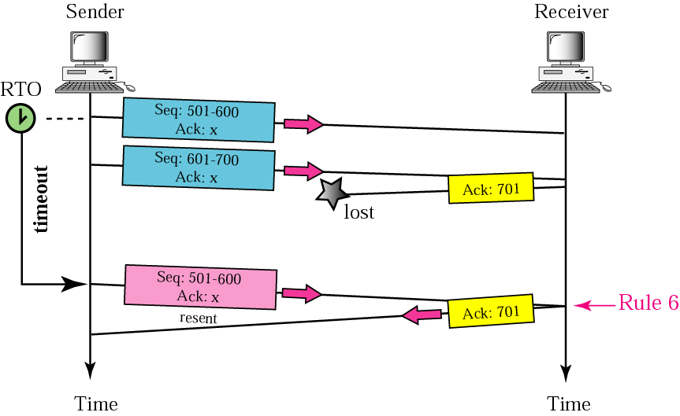
Figure 12.29 Lost acknowledgment corrected by resending a segment

Slide 55
Note:
Lost acknowledgments may create deadlock if they are not properly handled.

Slide 56
12.8 CONGESTION CONTROL
Congestion control refers to the mechanisms and techniques to keep the load below the capacity.

Slide 57
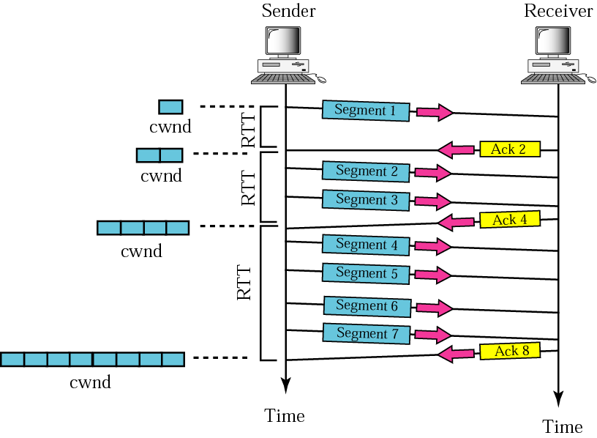
Figure 12.33 Slow start, exponential increase

Slide 58
Note:
In the slow start algorithm, the size of the congestion window increases exponentially until it reaches a threshold.

Slide 59
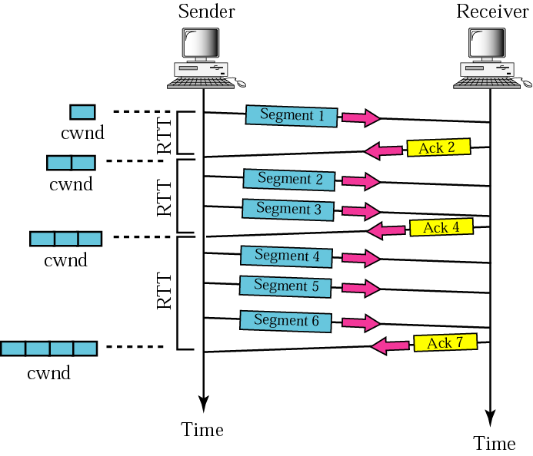
Figure 12.34 Congestion avoidance, additive increase

Slide 60
Note:
In the congestion avoidance algorithm the size of the congestion window increases additively until
congestion is detected.

